Slide 1
Pediatric Tuberculosis
Mien Chyi, MD

Slide 2
Objectives
Discuss practical pediatric TB evaluation and management
Introduce the latest Peds TB guideline revision
Practice with cases

Slide 3
Epidemiology
1 million new pediatric TB cases annually worldwide
< 400 new pediatric TB cases annually in the US
Our region’s overall incidence is 25-30 times the national average
From AK Dept of Public Health

Slide 4
The Challenges
“The Great Masquerader”
Slow-growing organism, difficult to detect and treat
“There are exceptions to every rule.”
Reasonable experts disagree
… But, TB is almost never an emergency

Slide 5
Your Human Resources
Other YKHC TB Officers
Lye-Ching Wong, MD (pediatrician)
Annette Ndagano, MD (outpatient pediatrician)
Elizabeth Roll, MD (family practice physician)
Robert Tyree, MD (outpatient family practice physician)
Elizabeth Bates, MD (Infection Control Committee chair)
Beeba Mathew, ANP (outpatient internal medicine practitioner)
TigerText “TB Officers” for urgent consults
Email TBOfficers@ykhc.org for general questions or non-urgent consults

Slide 6
Your Human Resources
Our extended team
Public Health Nursing 907-543-2110
Alaska State Epidemiology 907-269-8000
Curry TB Center (UCSF)/Warmline 415-502-4700 or 877-390-6682
currytbcenter@ucsf.edu
Jill Seaman, MD (YKHC family practice hospitalist)

Slide 7
Role of TB Officers
In partnership with PHN, case manage patients undergoing treatment for LTBI and active TB
Provide guidance to providers and PHNs on questions regarding potential or existing TB patients
Decisions/logistics regarding evaluation, diagnosis, and treatment
Medication adherence/tolerance issues
Provide liaison assistance between providers and State Epi and Curry Center

Slide 8
Three Contexts
Routine screening/testing
National recommendation: targeted testing based on screening questionnaire
Alaska State Epi recommendation: universal testing annually
Exposure to TB (contact investigation)
Clinical concern for TB disease

Slide 9
Routine TB Testing
Tests measure lymphocyte sensitization after infection
Tuberculin skin test (TST aka PPD)
Interferon gamma release assay (IGRA; we use Quantiferon-Gold)

Slide 10
TB Testing - Sensitivity
Conditions that decrease lymphocyte number or function can reduce the sensitivity of both tests (anergy)
Age, malnutrition, immunosuppression, viral infection
MMR, varicella, and Covid (!) vaccines (wait 4-6 weeks to test)
Severe or disseminated TB disease
Recent infection (window period)
10-40% of immunocompetent children w/ culture-proven TB disease have an initial negative test
Sensitivity persists: do not retest a prior positive!

Slide 11
TB Testing - Specificity
Cross-reactivity with nontuberculous mycobacteria – both tests
More species with TST than with IGRA
TST only
BCG
Boosting phenomenon

Slide 12
TST interpretation
5 mm: suspected TB disease, close contact to individual with confirmed OR suspected active TB, immunosuppression/HIV*, age < 6 months
10 mm: immunosuppression/HIV**, lymphoma, DM, renal failure, malnutrition, birth in or travel to high-prevalence area, exposure to high-risk adults
15 mm: no risk factors
Disregard prior BCG vaccination
Positive TST can be read for up to 7 days
*Curry TB Center
**CDC/AAP

Slide 13
IGRA Interpretation
Positive
Negative
Indeterminate/Equivocal
Child is too young (< 2 years old)
Test failure
Usually, repeat the test

Slide 14
TST or IGRA?
TST preferred if < 2 years old
IGRA preferred > 2 years old if BCG vaccinated or unlikely to return for PPD reading
You can do both: +TST but -IGRA in a child without symptoms or exposure is unlikely to be TB

Slide 15
Latent Infection or Active Disease?
Latent tuberculosis (LTBI) is the presence of M. tuberculosis organisms in a patient with no symptoms, signs, xray findings, or bacteriologic evidence of tuberculosis disease
LTBI can only be diagnosed after ruling out active disease

Slide 16
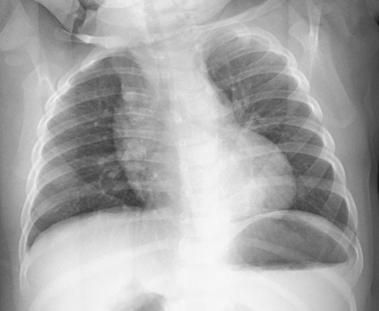
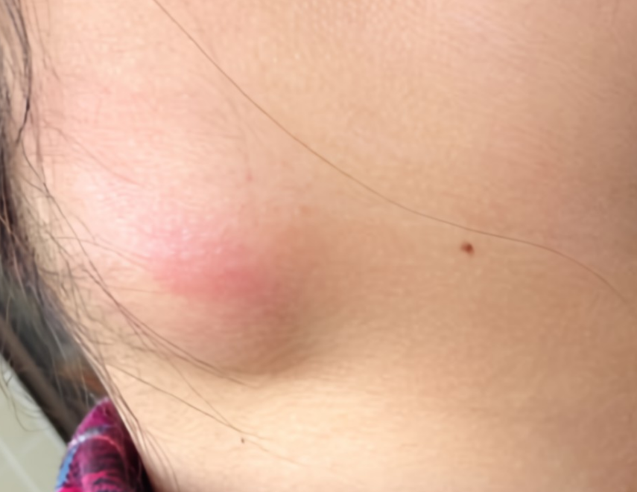
Sites of TB Disease
Pulmonary (>50%)
Lymph nodes
Intrathoracic
Superficial (scrofula)

Slide 17
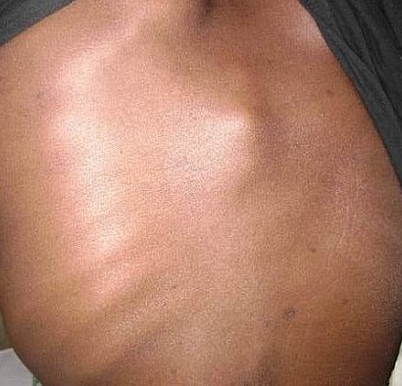
Sites of TB Disease
Brain
Bone/joint
Abdominal organs
Anywhere!
Everywhere!

Slide 18
TB Disease Evaluation
History
Pertinent medical history (TB history, chronic disease, immunosuppression)
Exposure (who, where, when, how long)
Symptoms

Slide 19
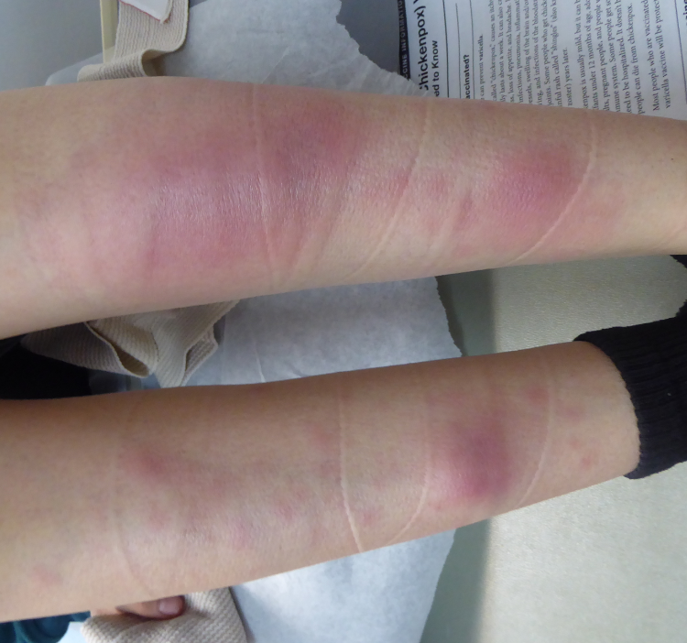
Symptoms of TB Disease
Fever > 2 weeks
Persistent cough (> 2-3 weeks)
Hemoptysis is rare
Weight loss or failure to gain weight
(Night sweats)
Erythema nodosum
Symptoms may be subtle or absent

Slide 20
TB Evaluation
Physical Exam
Temperature and growth measurements
Mental status
Abdomen, back, extremities
Superficial lymph nodes
Lungs
HIV testing
CXR

Slide 21
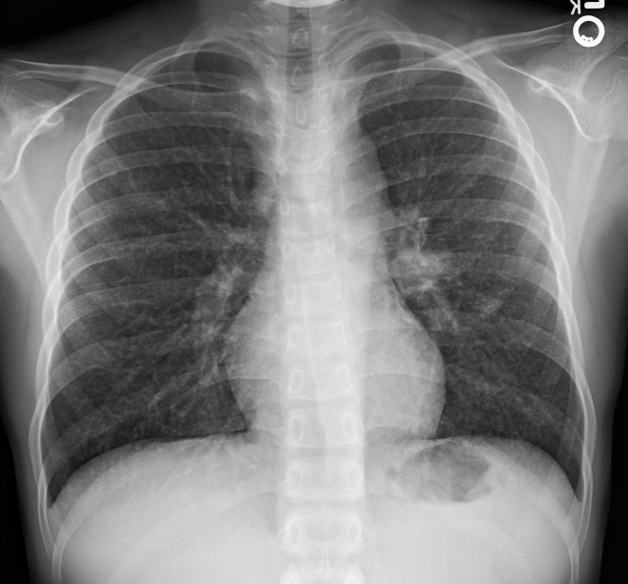
CXR Findings
Infiltrates
Atelectasis
Pleural effusion
Intrathoracic adenopathy
Miliary pattern
Cavitary lesions

Slide 22
LTBI
Always treat
Risk of progression
10% lifetime rate
Highest in the first 12 months after infection
Highest in children < 5 years old
Increased risk of severe or disseminated disease
Increased mortality

Slide 23
Exposure to TB
Statistically, identifies the most children with TB
Test with TST/IGRA if no prior TB history
Evaluate promptly with history, exam, and – if < 5 years old – CXR
If 5 years or older, immunocompetent, and everything is negative, repeat TST/IGRA 8-10 weeks after last exposure

Slide 24
Window Prophylaxis
LTBI dosage of anti-TB medication to prevent progression to active disease while waiting through sensitization period
For patients at high risk of TB disease
< 5 years old: Repeat TST/IGRA 8-10 weeks after last exposure
Immunocompromised: Likely treat for a full LTBI course
For older kids with ongoing exposure

Slide 25
Clinical Concern for TB Disease
Positive symptom screen, physical exam findings, and/or abnormal CXR
Maintain high index of suspicion
TB Disease is more likely if:
TB exposure
Specific CXR findings of hilar adenopathy, granulomas/milia
CXR findings out of proportion to symptoms

Slide 26
Clinical Concern for TB Disease
Positive AFB culture for M. tuberculosis is the gold standard
Sputum (spontaneous or induced, 3 samples collected 8 hours apart including one first-morning sample)
Sensitivity is < 50% in children
Gastric aspirate (3 first-morning samples)
Sensitivity is 40-50%, though > 75% in infants < 3 months
Other bodily fluid/tissue sample
Lumbar puncture for children < 12 months old with high concern for active disease

Slide 27
Clinical Concern for TB Disease
Consider alternative diagnoses
When in doubt, obtain cultures and treat for active disease

Slide 28
GeneXpert MTB/RIF Assay
NAAT on sputum samples that detects M. tuberculosis DNA and rpoB gene for rifampin resistance in < 2 hours
Run in-house for adult patients
Run by the state lab for patients < 18 years old
Our new gold standard to determine whether a patient is infectious

Slide 29
Public Health/Infection Control
Children < 10 years old are almost never infectious
Okay to travel
Strictly extrapulmonary disease is almost never infectious
Symptomatic children aged 10+ years should isolate at home (no school) and submit sputum samples to the local clinic; no travel until MTB is negative
Any new TB infection diagnosed in a child not identified through contact investigation triggers a contact investigation

Slide 30
LTBI Treatment
For pan-sensitive infection
3HP: 12 once-weekly doses of weight-based isoniazid (INH) and rifapentine (RPT)
Only for children aged 2 years and older
Directly observed therapy (DOT) preferred
4R: Four months of daily rifampin (RIF)
9 months of daily isoniazid (INH) – used to be the standard
(3 months of daily INH + RIF)
All are equally efficacious

Slide 31
Daily INH and RIF dosages
From Curry TB Center

Slide 32
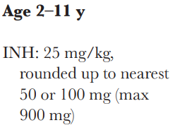
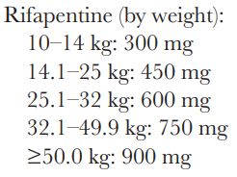
Weekly INH and RPT dosages
From AAP Red Book

Slide 33
LTBI Treatment
For INH-resistant infection
4 months of daily rifampin
For multi-drug resistant (MDR) infection
Consult TB officer

Slide 34
Active TB Treatment
Must be given with DOT
For pan-sensitive pulmonary or lymph node disease
“RIPE” – all drugs given daily
Rifampin x 6 months
Isoniazid x 6 months
Pyrazinamide (PZA) x 2 months*
Ethambutol (EMB) until pan-sensitivity is confirmed
*assuming medication adherence and clinical improvement

Slide 35
Daily PZA and EMB dosages
From Curry TB Center

Slide 36
Active TB Treatment
For INH-resistant disease
Daily rifampin, pyrazinamide, ethambutol x 6 months
For MDR disease
Consult TB Officer
For miliary disease, treat for 9 months
For meningitis or osteomyelitis, treat for 12 months
Additional drugs used in meningitis

Slide 37
Pyridoxine (B6) Supplementation
Prevention of drug-induced peripheral neuropathy
Give to patients taking isoniazid who have:
Breastmilk-only diet
Meat- or milk-deficient diet
HIV disease
Existing peripheral neuropathy
Dose: 1-2 mg/kg once daily; round to nearest ¼ or ½ of 25 mg tab

Slide 38
Treatment Monitoring
Medications are very well tolerated… sort of
More common serious potential side effects (very rare in kids):
Isoniazid: peripheral neuropathy, hepatitis
Rifampin: C. difficile colitis, hepatitis
Pyrazinamide: Hepatitis
Ethambutol: Optic neuritis, color blindness, decreased visual acuity

Slide 39
Treatment Monitoring
LFTs unnecessary – but we do them
Monthly symptom review
Repeat sputum samples – only if AFB-positive
Repeat CXR – only if initially abnormal

Slide 40
Pediatric TB Guideline

Slide 41
Case 1
12-year old healthy male with no TB history seen in Bethel clinic for WCC, Quantiferon positive
What questions do you have?
Review medical history, symptoms, exposure history -> None
What will you do next?
Bring back for CXR -> Negative

Slide 42
Case 1
Now what?
Diagnose with LTBI
Check HIV and LFTs
Treat for LTBI, ideally with 3HP
Inform TB Officers

Slide 43
Case 2
8-month old healthy female with no TB history seen in Bethel clinic for evaluation after TB exposure
What questions do you have?
Exposure history? Grandmother w/ INH-resistant disease and poor medication compliance visiting the home daily for over an hour
Symptoms? None, and no abnormal physical exam findings
What will you do next?
CXR -> Negative
Place PPD -> Negative

Slide 44
Case 2
Now what?
Admit for induced sputum collection; check HIV and LFTs
Start window prophylaxis with daily rifampin
Inform TB Officers
Follow up repeat PPD 10 weeks after grandmother stops visiting or becomes noninfectious

Slide 45
Case 3
8-month old healthy female with no TB history seen in Bethel clinic for evaluation after TB exposure
What questions do you have?
Exposure history? Two weeks ago, uncle who lives with grandfather who has MDR-TB came to visit for one night
Symptoms? None, and no abnormal physical exam findings
What will you do next?
CXR -> Hilar adenopathy
Quantiferon -> Positive

Slide 46
Case 3
Now what?
Admit for induced sputum collection and lumbar puncture
Diagnose with active TB
Curry TB Center consulted and recommended treatment with RIPE + levofloxacin
Inform TB Officers
Follow up medication adherence/tolerance and AFB results
Exposure history can be misleading

Slide 47
Case 4
RMT received on a 14-year old healthy female with no TB history who was seen in village clinic (SRC) four days previously for rash on bilateral lower legs x 5 days, diagnosed with erythema nodosum, and had PPD placed, now positive at 20 mm
What questions do you have?
Exposure history? None
Symptoms? None other than the rash, and no other physical exam findings
Do you have a photo of the rash? EN confirmed

Slide 48
Case 4
What will you do next?
CXR -> LLL infiltrate
Request 3 sputum samples for AFB culture and 1-2 for MTB/RIF testing
Diagnose with active TB
Check HIV, LFTs, and pregnancy test
Start treatment with RIPE

Slide 49
Case 4
What will you do next?
Advise isolation at home (no school) until MTB returns negative
(Consider treatment for community-acquired pneumonia)
Inform TB Officers
Follow up MTB results and coordinate any further evaluation

Slide 50
Case 5
18-year old healthy female with history of LTBI s/p treatment completion in 2009 seen in village clinic for evaluation of TB exposure.
What questions do you have?
Exposure history? Daily household exposure x 6 months, contact pan-sensitive
Symptoms? None, and no abnormal physical exam findings

Slide 51
Case 5
What will you do next?
Consult TB Officer (or higher-level expert)
Bring to Bethel for CXR -> Negative
Sputum collection for AFB testing -> Negative
Diagnose with possible/probable LTBI
Check HIV, LFTs, pregnancy test
Treat with 3HP

Slide 52
Case 6
16-month old healthy male with no TB history identified through contact investigation as having a regular caretaker (non-household member) with active TB (ongoing contact for months)
Initial evaluation: Asymptomatic, -PPD, normal CXR
Sputa collected, window prophylaxis begun

Slide 53
Case 6
8 weeks later, seen in clinic with cough x 4 weeks
S/p ten days of amoxicillin for AOM
New household contact with active TB
Lost TB medication
Chart review
No weight gain in 6 months
Prior AFB cultures no growth

Slide 54
Case 6
Diagnosed with active TB and started on RIPE
Struggled with pills -> switched to liquid
DOT aide unreliable
Had to restart/extend treatment due to poor compliance
Finally finished treatment 9 months after initial presentation

Slide 55
Summary Points
Evaluation of TB includes TST/IGRA testing (if no prior TB history), history, physical exam, CXR, and (often) AFB cultures
Sensitivity is poor: everything rules in but rarely rules out TB
Always treat LTBI
When in doubt, treat for active TB
Serious medication side effects are rare
Utilize your TB Officers

