Slide 1
YKHC Provider Training:
Medical & Surgical Case Management
Updated 08/2024
Matt Scott, RN, SRC Case Management/PI

Slide 2
Types of Case Management at YKHC
Types of Case Managers:
Adult
Pediatric
Women’s Health (Includes OB/GYN & Prenatal)
Emergency Department
Surgery – (split CM duties between EGD/Coloscopy and everything else)
Physical Therapy
Dental
Multiple Role – Adult/Peds, SRC specific
How patients are split up for Case Management:
POD – Refer to Banner Bar in Powerchart to know which POD each Patient is in
SRC – The 5 Sub Regional Clinics have additional support for case management outside of POD Case Managers. 2 staff RN’s help with additional coverage in Aniak, Emmonak, Hooper Bay, Toksook Bay & St. Mary’s

Slide 3

Who do I Contact?
Check PowerChart “Banner Bar” for Patient Information First
The Patient POD is found here
Patient home village is found here

Slide 4
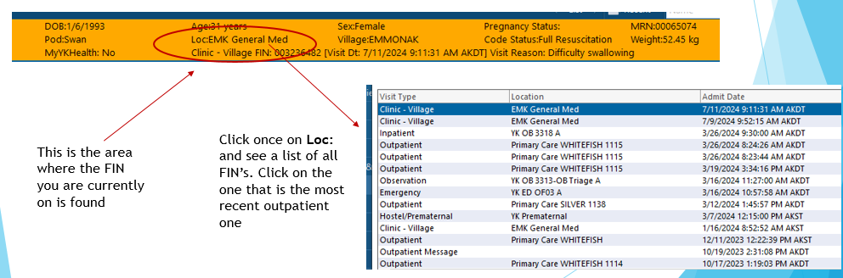
FIN (Financial Information Number), aka “specific encounter”
Make sure you are in the correct FIN (specific encounter). This matters heavily when ordering items.
You encounters are all OUTPATIENT. Please make sure you are ordering on an outpatient FIN. Orders from being on the wrong type of FIN (inpatient, ED, Pre-reg) will not route correctly and cause delays in patient care.

Slide 5
How Can We Help You?
Once you know which POD and/or Village location the patient is in, you can refer to the staffing list for Case Management (shown on next slide). It is a good idea to have this list saved to your HomDir folder and/or printed near your work area for reference.
This list is updated regularly for staffing changes and sent out to all providers via E-Mail by Case Management and Leadership staff.
This list has a lot going on! Take time to familiarize yourself with it and ask your supervisor or a Case Manager to explain it if necessary.
Don’t stress, each Case Manager will assist you in getting to the correct place, especially when you are new to our system.

Slide 6
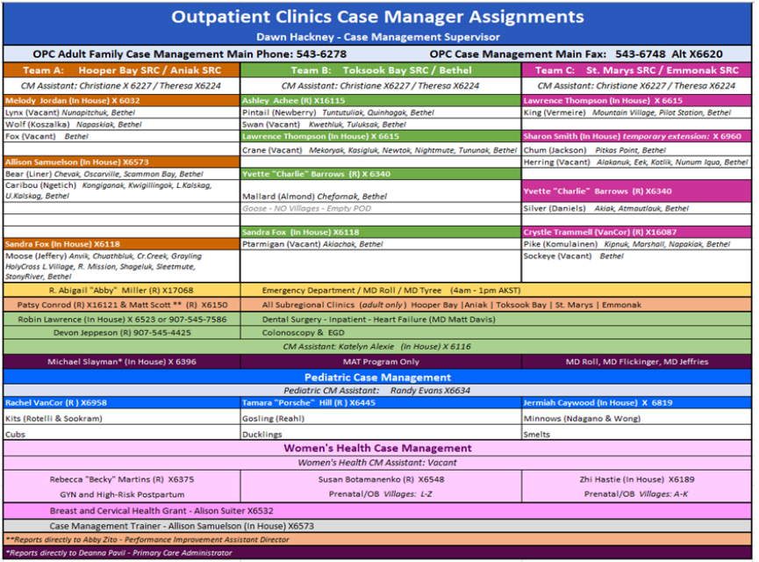

Slide 7
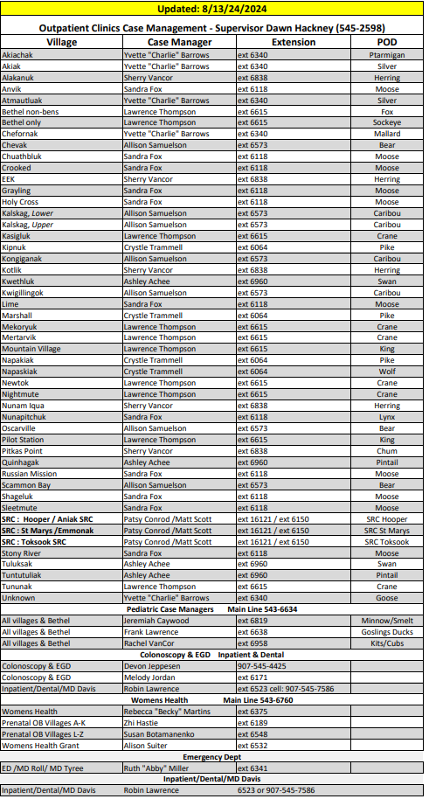
Click on image for a larger, easier to read version

Slide 8
How do I contact Case Management?
How to contact a Case Manager should be situational. You have several options for communication, but each has special considerations.
TigerConnect, PowerChart Message Center, aka Direct Secure Message or ‘DSM’, E-Mail and Phone are all at your disposal
We will review the uses and limitations of each, and when one should be used over another

Slide 9


Informal Communication - TigerConnect or “TigerText”
Perhaps quickest and most common way at YKHC today to reach someone. This useful messaging app is secure, meaning that you CAN text patient information freely within it
Connected to staff at YKHC, ANMC and Patients (separate trainings on TigerConnect available)
Use like texting: When needing to ask general questions or chat. PLEASE, LIMIT USE when sending specific patient requests. This is best saved to the chart utilizing the PowerChart Message Center.
  *Note* TT messages last for only 4 days, so if a case manager is out of the office, the message may be missed entirely. Make sure your messages are in a ‘read’ status if it is urgent. and LOOK FOR this symbol:

Slide 10

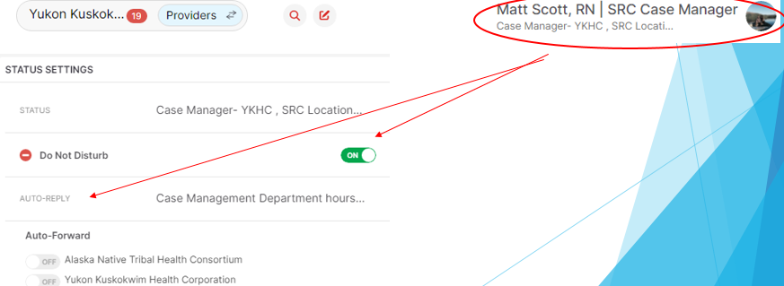
Informal Communication - TigerConnect or “TigerText”
A word about Do Not Disturb and Auto-Reply:
LOOK for this symbol and please be mindful of it :
Set Auto-Reply messages while on DND: This is an expectation at YKHC for all medical/nursing staff
To set this, click on your Profile name as shown:

Slide 11
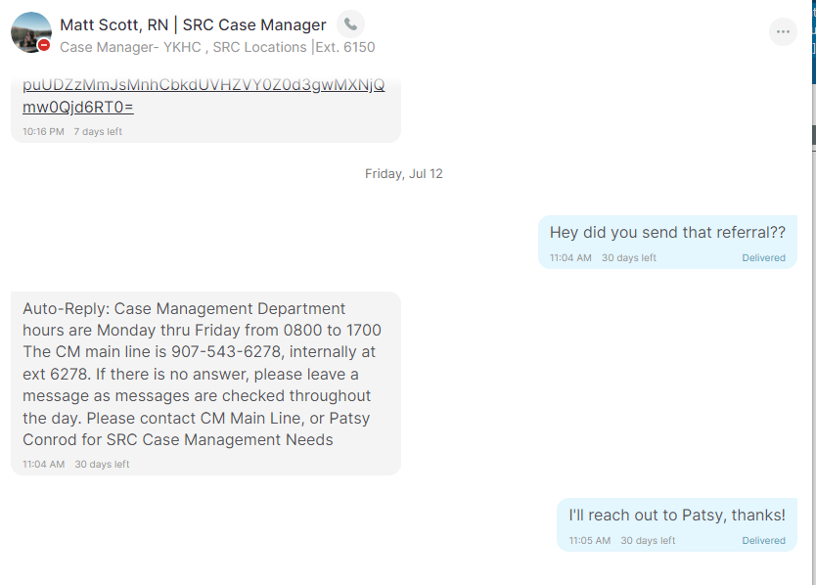
Informal Communication - TigerConnect or “TigerText” – What a DND with Auto-Reply looks like:

Slide 12
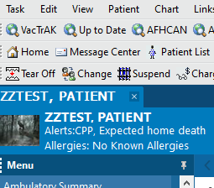
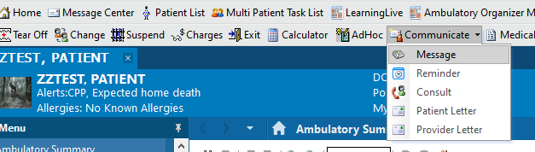
Formal Communication – PowerChart Message Center & ‘Communicate’
Clicking on the Message Center icon shows your inbox.
Sending a message on a specific patient regarding care while in that chart is done via “Communicate”
This is the best way to communicate care needs regarding a specific patient to a specific Case Manager or a “pool”

Slide 13
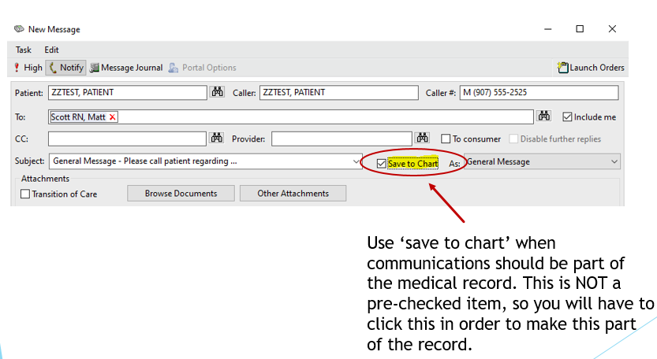
Formal Communication – using ‘save to chart’

Slide 14
Formal Communication – Message Center – Individual Vs. Pool
Sending messages to individuals or pools, how do I know?
You are busy and do not always have time to find which individual you need to communicate with regarding a patient – to account for this, Pools were created for you to send general messages about patients
The appropriate Case Manager will check the pool and select the patients they are responsible for (as well as disseminate to other staff)
If you know which individual you would like to send a message to and prefer that option, you can also do that

Slide 15
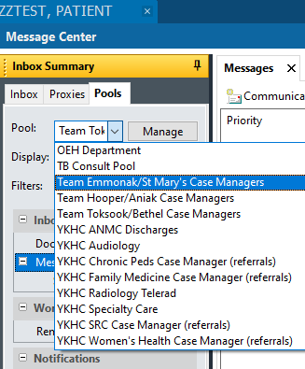
Formal Communication – PowerChart Message Center – Pools
Click on your “Message Center” icon – choose the ‘Pools’ tab
Choose the appropriate pool to send to based on the patients location. These pools marry up to the Case Manager Assignment Sheet show previously
Case Management reviews pools multiple times each day to monitor needs

Slide 16

General Communication - Phone and E-Mail
Numbers/Extensions for all Case Managers and Case Manager Assistants are listed on the main Case Management staffing sheet – Call whenever necessary, sometimes verbal is the best way to communicate.
E-mail can be useful general information, but it is not timely and a less effective way to communicate anything related to patient care. It is less secure than Direct Secure Messaging (DSM) from Message Center or TigerConnect (TT) and therefore not preferred for this type of use when message center is an option. Do not expect timely replies as Case Managers do not typically live in the e-mail space like they do with TigerConnect and Message Center.

Slide 17
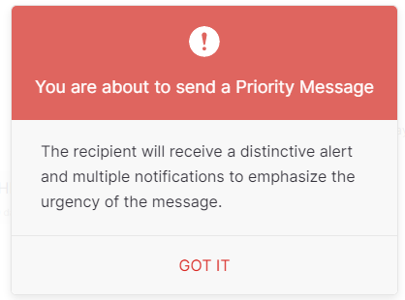
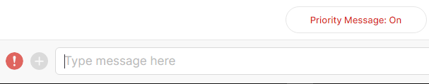
URGENT COMMUNICATION – TigerConnect: Priority Messaging
Have a truly urgent situation? Priority Messaging from TigerConnect may be the answer
This type of message will send a loud auditory alert as well as a red-outlined message. This will get the person, or group’s attention that you message, so use it only when necessary. It will disturb those on DND as well, so please, be considerate if choosing this option.

Slide 18
Common Case Management Duties: Sending Referrals
Sending referrals makes up a large portion of a case managers daily duties. Each year YKHC produces thousands of referrals, most of which are sent to Alaska Native Medical Center (ANMC). We are very effective at sending these out within 24 hours of the order being placed provided all the necessary items are in place for the referral from the provider.
In the following slides, we will cover types of patients served at YKHC, types of referral orders, what is needed for each type of referral and common issues that prevent case managers from sending them out quickly.

Slide 19
Referrals 101: Beneficiary vs. non-Beneficiary
“Beneficiary” refers to someone who is American Indian or Alaskan Native (AI/AN), and is entitled to certain benefits as agreed upon with the Indian Health Service (IHS) and receive care from IHS or Tribal institutions, such as YKHC and ANMC/ANTHC and more. This is more than 95% of YKHC’s service population, and the primary focus for YKHC as a service provider.
A “Non-Beneficiary” (non-ben) is someone who's race is listed as something other than AI/AN, and therefore DOES NOT qualify for internal or external referrals sent to ANMC or other IHS/Tribal institutions.
If patient is a “non-ben”, the patient is responsible for choosing where they would like their referrals sent based on their insurance. *CM does not assist with insurance discovery*. Choice of provider should be noted within the order details
If patient is a beneficiary, and they want a non-ANMC second opinion (Medicaid/Medicare used as insurance), inform the patient that they will be financially responsible for whatever Medicaid or addtl. insurance does not cover.

Slide 20
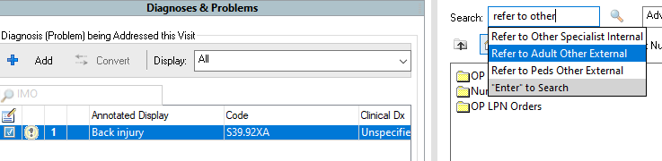
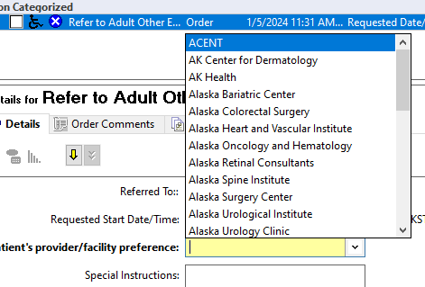
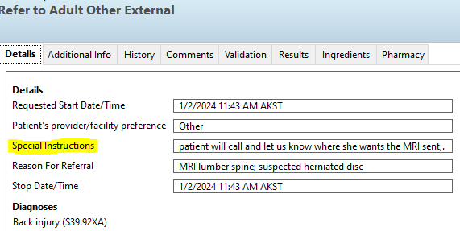
Example: Adult Referral Order for non-beneficiary, and one who needs an MRI
Use the ‘Refer to Adult Other – External’ order
Many options will be provided for patients to choose from in the required field, as well as a free-text option within the Special Instructions

Slide 21
Referrals 101: Types of referral orders
There are numerous types of referral orders available to you within our Cerner system. Learning them all and how they fit with other care systems in Alaska will take time, experience and good communication with a case manager.
Internal referrals vs. External referrals: Referral orders may have two versions; Internal and External. Each has considerations.
  Internal referrals mean that you would like the patient to be seen at YKHC in Bethel vs. outside of the YKHC service locations. For most specialties, ANMC operates “field clinics” located in Bethel. Once an Internal referral is placed, these types of referrals will end up on a worklist, or a “request queue” for scheduling by the ‘specialty clinic’ department. A calendar for Specialty clinic is always available to you and sent out via email several times per year.
  External Referrals are sent on to ANMC or other institution for scheduling and processing.

Slide 22
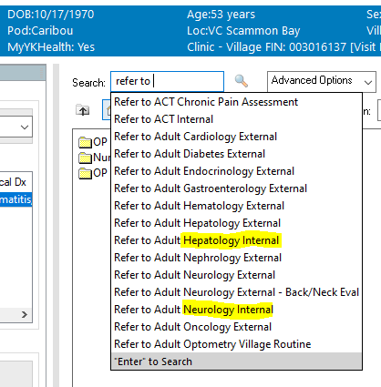
Referrals 101: Anatomy of a referral order
Start with “refer to” in your search box for all referral orders.
Note that Adult and Pediatric referrals are different orders.
Note that there may be an “internal” and an “external” version of the same order. Place the correct one for your situation. Different case managers will process each differently.
*Not all specialties have an internal order as they do not come to Bethel for field clinic

Slide 23
Referrals 101: Considerations prior to placement of referral order
Have completed documentation and signed with updated images/studies if needed
Make sure note reflects the reason for the referral and mentions inclusion within the order of pertinent pictures and/or studies
STAT referrals: STAT referrals MUST have a provider-to-provider conversation with the ANMC Specialists attending/doc on-call. This conversation should be saved to chart. Let CM know you have placed a STAT by TigerText. Make sure notes are signed and images/studies are loaded into MultiMedia Manager prior to contacting CM. If these steps are not followed, there will be a delay in care.
If pt.. is beneficiary, and they want a non-ANMC second opinion (Medicaid/Medicare), inform the patient that they will be financially responsible for whatever Medicaid or any external insurance they have, does not pay for.

Slide 24
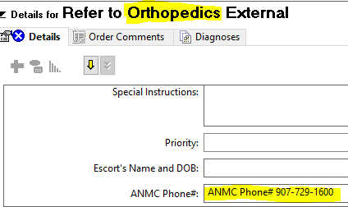
Referrals 101: General information
Do not enter multiple referrals for the same issue within a one year period. –This will actually cause delays- Please check the Documentation filter - shown in a subsequent slide- for any prior referrals sent first.
*PLEASE NOTE* Case Management can not make ANMC appointments for patients. Please, educate patients to call ANMC services for updates/appointments while you are making the referral order! The number for the service is included within the referral order itself.

Slide 25

Internal Referrals to YKHC Departments: Dental
Urgent dental needs:
Bethel patients: Welcome to walk in to dental to be seen. 2 providers covering walk-ins. If patient has patience and is willing to sit in the waiting room they can likely be seen the same day without any need for referral.
Urgent needs from Villages: Send a message to the dental team in Tiger Text to the ‘Emergency Dental Consult’
Alternatively, a consult can always be done with dental during work hours (8am-6pm) by calling the dental front desk (x6229) and asking to speak with the Triage Dentist.
Non-urgent dental needs:
advise your patient to call our front desk to schedule**. (For the best chances of getting an appointment call promptly at 9am Monday-Thursday). Number is 907-543-6229.

Slide 26

Internal Referrals to YKHC Departments: Optometry
Routine Eye Exam
Patients do not need a referral to schedule an appointment with Optometry if they are in Bethel
If the patient has not been seen within the last year, patient can make an appointment at their earliest convenience
  Bethel or Village based and would like to be seen in Bethel – pt. can call to schedule themselves or you can call 543-6336 while the patient is in the room with you
    If your patient needs to travel from the village to see Optometry:
      Travel will need two things:
        Diagnosis - You will need to state in your note why they need to be seen with Optometry
        Referring Provider – this does not have to be an optometrist, it can be any provider or patient can be seen with a HA and we will be the referring provider via RMT
  Village based and would like to be seen in the village – Refer patient to “Optometry Village Routine” and we will see them on our next trip out to their village -
Red Eye Evaluation
Gather all information required from the consultation check list prior to consultation
Send pictures
Consult Optometry On-Call via TigerText before sending any urgent/emergent village patients to Bethel
The fastest way for a provider to get a patient scheduled with Optometry is to call 543-6336 while seeing the patient
Patients leave with an appointment time and date
Immediately after our front desk team schedules the patient, the appointment information is emailed to travel for processing, and cc’ed to the patient’s village clinic
All travel questions or concerns should be addressed with the travel department or the village clinic
Patients should be encouraged to follow up with either their village clinic or travel if they have not received flight information a few days prior to their appointment
If you don’t reach someone at the front desk right away, please try calling back. If you are unable to reach someone and your patient needs to leave (or if this is after hours or during weekends), you can TigerText the Optometrist on-call with the following information:
Patient Name, DOB, phone number, and reason for exam. You will be noted as the referring provider. We can then forward this to our front desk to schedule.

Slide 27

Internal Referrals: YKHC Departments – Audiology, Diabetes (SDPI Grant), Physical Therapy
Audiology – All Audiology and ear-related ENT referrals are sent to “Refer to Audiology Internal”. For questions; TT “Audiology Team” role.
Diabetes (SDPI Program) – Multiple referral types, including Provider visits, Self-Management & Medical Nutrition Therapy. Please reach out to Diabetes department via TT at:
Physical Therapy - Case Manager: Keira Gefroh
  Use ‘Refer to Physical/Occupational/Wound Therapy Internal’ and ‘Refer to Speech Therapy Internal’. All internal/external referrals will be managed by Physical Therapy department.

Slide 28
External Referral Order Guidelines by Service:
Cardiology: EKG IS REQUIRED, labs, Chest X-ray if indicated
Dermatology: PICTURES are REQUIRED with all derm referrals, also remember to list treatments/medications previously tried
Endocrinology: Consider TSH, T3, Free T4
Hepatology: Liver US, Liver Panel, Hep B panel if patient has Hep B
MRI- Refer to Internal Medicine External, please answer all yes/no questions on order. These are required for MRI order
Neurology: CT or other imaging within last 6 months
Neurosurgery: X-ray within last 6 months required
Nephrology- Renal US, Renal panel, UA, UPCR, CBC Ortho- current X-rays
Pulmonology: CXR, AFBx3, QuantiFERON, sputum culture, CBC, CMP (other labs as needed)
Rheumatology: X-rays if deformities present, labs: CBC, CMP, CRP, ESR

Slide 29
Current Referral Order Guidelines by Service:
Surgery- Please pay attention to order. REFER to Adult Surgery External (No EGD/CS) – all other surgery referrals. For EGD/CS – please order Refer to Adult Surgery External (only EGD/CS) DO NOT order a GI referral for EGD/CS.
Urology – UA, Urine Protein/Creatinine, Renal US (if indicated), -If referring for sterilization, Federal consent to sterilize is REQUIRED. Fill and sign with the patient at visit.- ensure you are using the most recent consent form, or it will not be valid. *note this is separate from procedural consent*
Pain Management: Multiple requirements, outlined in a following slide
Non-Beneficiaries • Referrals to Ortho, NSGY ( or anywhere that needs imaging)- Please order a disc from radiology for the patient to pick up to take with them to their appointment. •
Refer to other external: Please obtain info on where patient wants a referral sent. If they do not know- let them know to get started with the homework and be prepared with referral information (where they want to be seen) prior to CM or CM Assistant calling them.
Providers/Nurses can always google Providence Hospital, click on website, click on Find a Doctor, search for specialties, put in Anchorages Zip code or Bethel Zip code (just pick 500 miles if using Bethel zip code) and there will be a list of Providers and their offices and if they are accepting new patients, click on the provider you want and there will be a phone number to add to referral. A couple choices would be nice. Also let patient know that they will need to make sure that the office accepts their insurance.

Slide 30
Current Referral Order Guidelines by Service:
ANMC Orthopedics
Urgent/Emergent situations require a TELERAD
  The TELERAD serves as ANMC Orthopedics referral. Do not also order a “refer to Orthopedics-External” if you have sent a TELERAD
Non urgent/chronic issues
  if a TELERAD is not needed, you will need to place a ‘refer to Orthopedics- External’ and ensure you have you documentation signed and current XR studies so they can be sent to ANMC PACS system.

Slide 31
ANMC Telerad Process:
You must use the following form when submitting a Telerad to ANMC:
https://forms.anthc.org/orthopedic-teleradiology/
For emergencies, please continue contacting the on-call ANMC Ortho Field Support Surgeon at 907-729-1791. After 5 PM and on weekends, call the ANMC operator at 907-563-2662 to reach the on-call surgeon.
Where to Find the Form:
Orthopedic Services | Alaska Native Tribal Health Consortium (anthc.org)
Go to ANTHC.org
Under “What We Do,” select “Specialty and Tertiary Care.”
Choose “Orthopedics.”
Under the “Services” tab, find the form button.
Click the “Telerad Services” button to open the form.
Fill out the form completely, ensuring all required fields are completed.
You will receive an email confirmation once Orthopedics staff opens the form.
Or simply save this link to your Favorites: Orthopedic Teleradiology Form.
For training needs, email Telehealth at _AKA-TELEHEALTHPS@anthc.org.

Slide 32

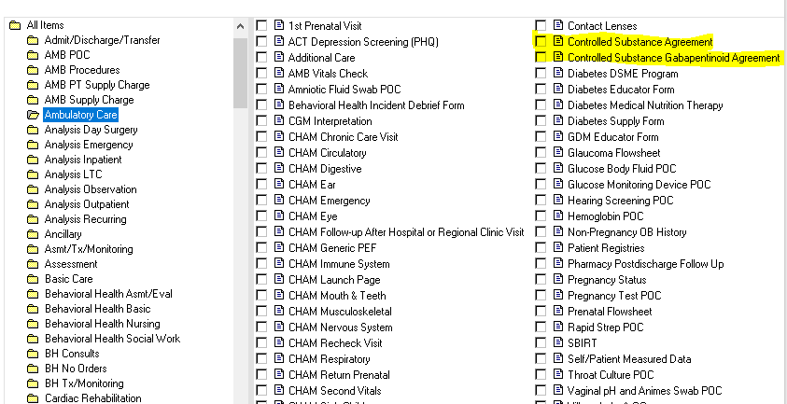
YKHC Pain Contracts
  To complete a controlled substance agreement; click on 'ad-hoc', then "All Items", then "Ambulatory Care“
    Click "Controlled Substance Agreement" or/and "Controlled Substance Gabapentinoid Agreement" -for chronic opioids or Gabapentin respectively.

Slide 33
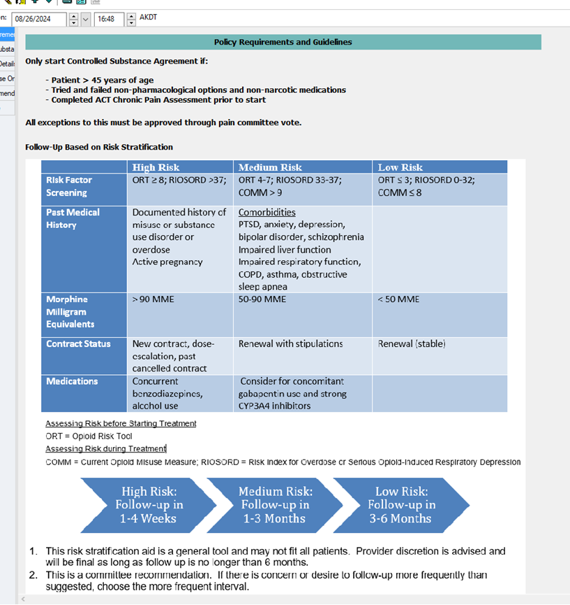
YKHC Pain Contracts
Policy in Powerform

Slide 34
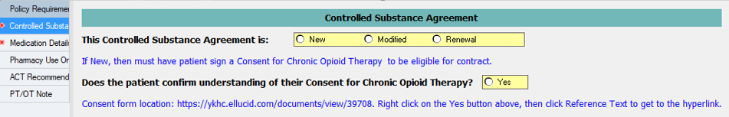
YKHC Pain Contracts
Pain contract patients:
  Pain contracts need renewal every 6 months per YKHC Policy
  If you are seeing a patient that has a pain contract, please review their contract date to see if it needs renewed while they are there at the visit.
  INITIAL contracts only need a paper-based consent form signed and scanned into Multi-Media Manager. Renewals are completed using only the ad-hoc powerform, no further signatures are required.
    Pain contracts are a YKHC policy only, NOT a legal document. YKHC pharmacists will be looking for the ad-hoc form when sending pt. appt. requests, so please use this process.

Slide 35
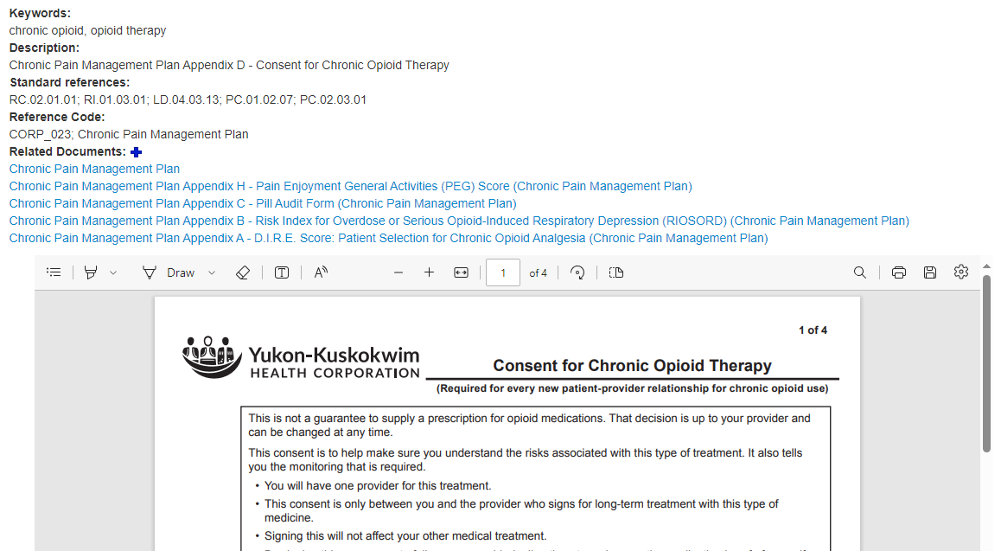

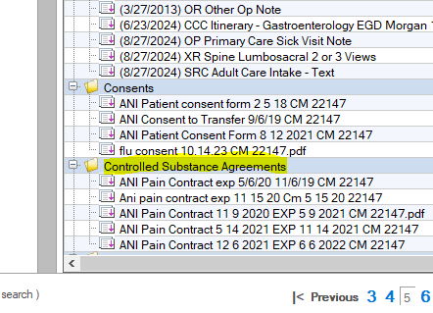
YKHC Pain Contracts – Consent for initial treatment
Once this document is signed, it should be placed into Multi-Media Manager as shown

Slide 36
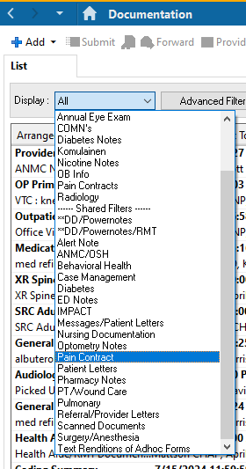
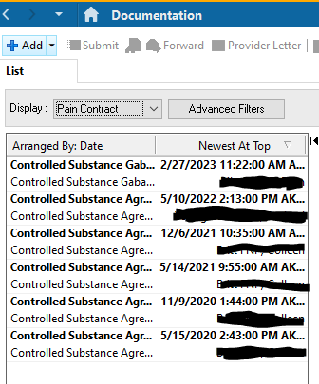
YKHC Pain Contracts
*how do I know if this is an initial contract or a renewal?
- You would use a quick filter in documentation to know how many of these forms have been done, and when. See example below:

Slide 37
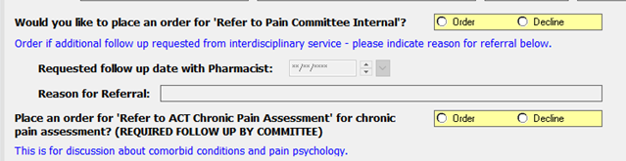

YKHC Pain Contracts
Need help with a challenging patient? Not sure what to do next? Thinking of cancelling a contract?
Consider sending a referral using the easy buttons within the contract to the YKHC Pain Committee. This automatically places and order for the MAT pharmacist to review. Each referral is discussed in a multidisciplinary committee format.
Need in-the-moment help?
TigerText the MAT Pharmacist!

Slide 38
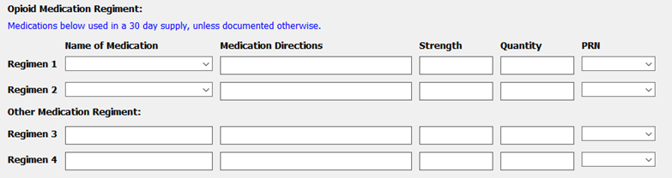
YKHC Pain Contracts
Please! Be sure to fill out all the medications in this area of the form. Without this information, the agreement is not useful to the pharmacy and cannot be processed.
Sometimes even more help is needed; refer to the ANMC Pain Management details on the next slide for further assessment

Slide 39

ANMC Pain Management Referrals
Chronic Pain Management Clinic at ANMC (CPMC)
  1. Basic documentation needs PRIOR to making referral: NSAIDS tried for 3 weeks? _ 6 weeks of home exercise/PT? _6 weeks of activity modification? _Motor exam in PCP note?
  2. Ensure pt.. has 6 weeks DOCUMENTED PT intervention prior to referral
    Place this order if not found
    STOP: do not refer until 6 weeks of PT completed
  3. Comprehensive Pain Management Questionnaire is REQUIRED
  4. Indicate in note that questionnaire has been given to patient.
  5. Have patient fill out at appointment and turn in before leaving.
  6. Completed questionnaire should be scanned into Multi-Media Manager in chart.
  7. X-rays within last 4 YEARS
    Any XR studies needing to be ordered must be: MINIMUM 4 Views + FLEXION & EXTENSION is required by CPMC.
  After three documented attempt to contact the patient, or absence of PT evidence, CMPC will cancel the referral. The patient will then need to reschedule an appointment with the provider for a new referral.

Slide 40
Prenatal Case Management
Prenatal Case Managers: Zhi Hastie (Villages A-K) x 6189 Susan Botamanenko (Villages L-Z) x 6548 &
For prenatal specifically, orders you might place are as follows:
  ‘Refer to High Risk OB internal’-any high risk diagnosis/problems you want to address with the HROB team to discuss every Friday at rounds
  ‘Refer to Obstetrics External-Future Transfer of Care’ (for all transfers outside of YK)
  ‘Refer to Obstetrics External-Perinatology’ (this goes to Maternal Fetal Medicine @ ANMC)

Slide 41

Women’s Health – CDC Grant, Breast & Cervical
Breast & Cervical Grant
  The CDC provides a grant to YKHC for certain Women’s Health situations. It can ONLY be used for Mammograms or cervical cancer screenings.
      To place an order for this, choose:
  Patients need to fall under specific CDC guidelines and qualify by INCOME. The may or may not qualify depending on when they were last seen for a screening Cervical cancer screening/Mammo and what their last result was or when they are next due
  This grant can also cover abnormal symptoms, even though they may technically not be due yet (Breast pain, breast lump, cervical abnormalities requiring colposcopies and/or LEEPs)
  This grant DOES NOT cover for patients to travel in for general women’s health issues, birth control or pregnancy (unless they are also due for screening or follow up for abnormal symptoms)
  The Grant will try to coordinate with other appts/departments as needed, but appropriate communication should be made to Alison Suiter, WH Case Manager x- 6532 or TigerText
Non-screening type breast referrals go to External Surgery Department using the following order:
  These should be covered by Medicaid and MAY qualify for the women’s health grant funding for travel (not all appts can be covered by the CDC Grant)

Slide 42
Women’s Health – GYN/High Risk Postpartum
Rebecca Martins, RN is your GYN/High Risk Postpartum Case Manager.
  Ext-6375, and also on TigerText
Cervical Referrals may start with Dr. Compton here or sent direct to External GYN/ONC by using the following orders
    ‘Refer to Gynecology External’
    ‘Refer to Gynecology Internal’
Internal GYN Referrals should be for patients or issues that should ONLY be seen by a GYN and not a PCP/WH provider
  Infertility- Refer to Gynecology Internal, Rebecca and Dr. Compton will review
  Prolapse - Refer to Gynecology Internal, Rebecca and Dr. Compton will review
  Vaginal Bleeding, PMB - Refer to Gynecology Internal
  *Order US transvaginal for ANY type of abnormal vaginal bleeding
ALL female sterilizations are ordered as ‘Refer to Gynecology External’

Slide 43
Women’s Health General Referrals & Follow Up
General Referral Info
Non-beneficiaries patients will need to find their own private provider and then can call us to notify us where to send their records
Patients are always contacted by Case Management when sending a referral
  To be notified of the referral
  To be asked about insurance coverage, notified of their responsibility to pay for travel or to ask Grant qualification questions
  They are also given the ANMC Department (Surgery, GYN/ONC) number to call if they have not heard from anyone about an appts in 2 weeks. This is our standard in WH. It then falls on the pt.. and is their responsibility to follow up with them or call us back if they are having trouble getting appts or aren’t receiving feedback from ANMC

Slide 44
Follow Up Appointments using Orders
Please remember, it is an expectation to place follow up orders during your discharge on most patient encounters. This will ensure the feedback loop for our scheduling system and ensure future appointments are made.
Follow up orders should be placed with regard to where the patient lives, NOT the provider location!
  How do I know where the patient lives? Check the VILLAGE at the top of any chart:

Slide 45
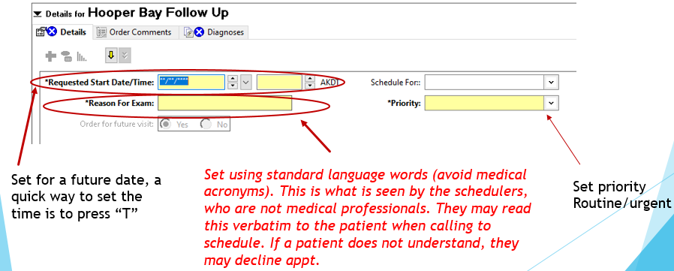
Follow Up Appointments using Orders
Examples of F/U order – in person:
  “Hooper Bay Follow Up” – means, please return to Hooper Bay for an in-person appt.

Slide 46
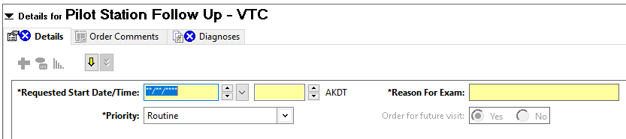
Follow Up Appointments using Orders
Example of F/U order – Video Teleconference (VTC):
  “Pilot Station Follow Up - VTC” – means, please return to Pilot Station clinic for a VTC appt.
  Why to use? – The patient LIVES in Pilot Station, not the SRC village you are working in. this allows a way to follow up remotely. Placing this order allows the scheduling team to make the appt. correctly.
  Which order to use? – the SRC locations have smaller villages in their ‘service region’. Patients from these locations may only travel to you physically once a year or less. A VTC will allow you to keep in touch with patents without the logistics of travel.

Slide 47
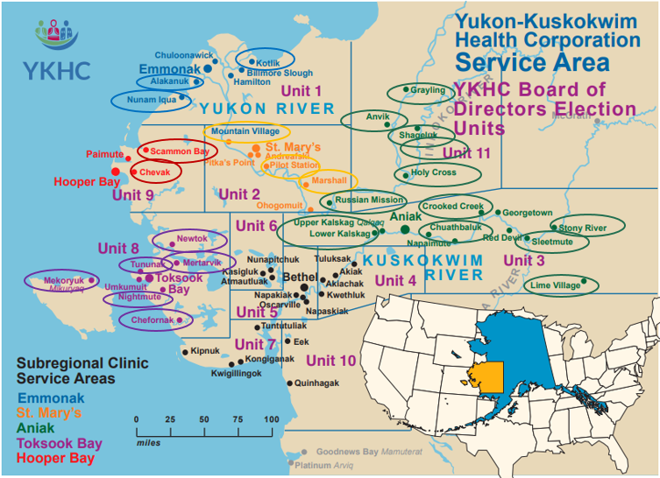
SRC service region villages - VTC orders should be considered in corresponding villages (denoted by color):

Slide 48
Surgical Case Management
EGD/CS Surgery CM is Devon Jeppesen, (907)545-4425
still working on a huge EGD/Colonoscopy backlog from COVID
  Internal EGD and/or Colonoscopy orders:
    Thousands (3000+) on request queue for internal orders. This includes past due orders, current orders and future orders (not due as of today) there is no way to separate out past due and current from future on this list.
      Please keep in mind we only have 2 regular endoscopists here on site and we do not scope full time. For 2024 on average we scope about 10.25 days per month.
    If you feel a pt.. is way overdue or you are concerned for any reason, please order as urgent and feel free to reach out to me via TT to ask me to get pt.. scheduled as soon as possible. I can generally get these pts in quickly (within a couple weeks depending on scope schedule and travel). The urgent and past surveillance/diagnostic orders are the priority to be scoped at this time.
    If you have pts who are screening (no family hx CRC, no history of polyps, no concerning symptoms) please offer and encourage them to do an IFOB, if it is positive they should get urgent order for colonoscopy and if negative they can get future order for colonoscopy in 1 year from negative IFOB date.
    If you have surveillance pts (family hx CRC or personal history of polyps) and are due now or in last year I will probably not get to them for a while realistically, please offer and encourage these pt.s to have an IFOB, if negative leave order as is and if positive put in urgent order for colonoscopy.
    We do not do dilatation or hemorrhoidectomy/banding here at YK, these pts need referrals to ANMC.

Slide 49
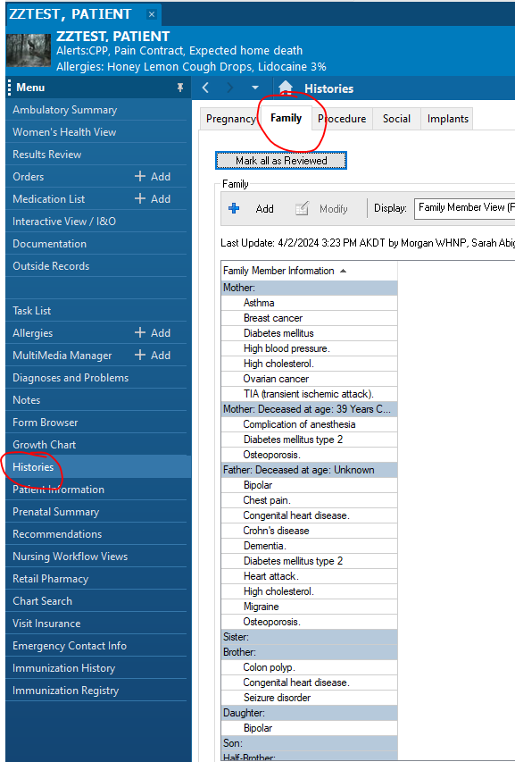
Surgical Case Management
  Important order reminders:
    Screening: only pts who have never been scoped or only ever had normal colonoscopies. Once a pt.. has fam hx or polyps they will never be screening and should NOT be ordered as such.
    Diagnostic: any pts with current symptoms (rectal bleeding, abd pain, anemia, GERD, etc.)
    Surveillance: history of colon polyps and/or family history of CRC. Family history is 1 first degree relative or 2 second degree relatives.
      Family history needs to be documented in chart in Histories>Family section:

Slide 50
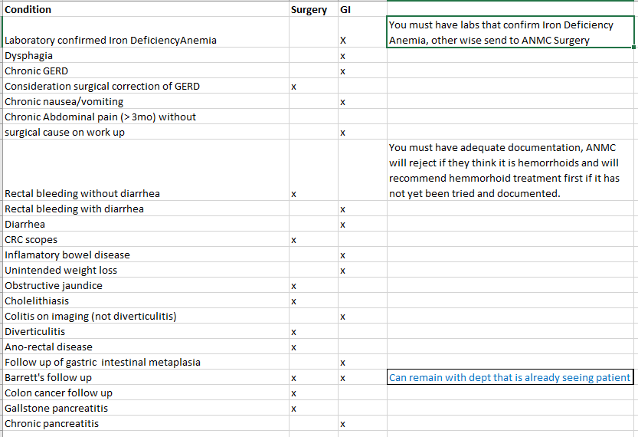
Surgical Case Management- Surgery or GI?
What should go where? Please reference this guide to know what referral to place:

Slide 51
Surgical Case Management
Remember: the more info you can put in the order the better!
  When placing external orders it is best to include as much info as possible and you can indicate if you are sending it b/c pt.. does not clear for here… Some order examples:
    Dx: history of colon polyps, Special instructions box: fm hx CRC, last scope 2018, pt.. over due for repeat. Pt not cleared for scope at YK for elevated A1c.
Or
    Dx: history of colon polyps, Special instructions box: fm hx CRC, last scope 2018, pt.. over due for repeat. Limited provider availability for scope at YK. (this phrase “limited provider availability for scope at YK” is code for pt. prefers/requests scope at ANMC as we can’t say this b/c of Medicaid…)
      Diagnostic endoscopy: put in as much pertinent info in order as you can. Your visit note must address the diagnosis, this note is required to be sent with the referral.
GERD:
  Referral goes to ANMC GI.
  Pt needs to have chronic GERD with failed PPI trial x8 week documented in visit note.
Anemia:
  Iron Deficient Anemia referral goes to ANMC GI.
  Anemia without iron deficiency referral goes to ANMC Surgery.
  If you think pt. is anemic use AMB anemia Powerplan, these labs must be sent with the referral to GI. H&H alone are not enough and these referrals are kicked back to us. If you order a CBC and H&H is low, place add on order for Iron Profile.
Rectal Bleeding:
  Notes must be thorough, be clear in orders. If you suspect a hemorrhoid but want patient scoped you must clearly indicate this. Offer Anoscope, digital rectal exam, put in as many details in your note as you can regarding the rectal bleeding, how much, when, color, is it on stool, is it on TP… when you place the order put notes in the order and be clear that regardless of hemorrhoids, you want pt. scoped. Try to keep these pts in house if we can. Our docs will scope them but remember we do not “fix” hemorrhoids here at YKHC.
  This is what I am getting back when they reject referrals for rectal bleeding:
Bleeding hemorrhoids are a very common reason for referral to general surgery: A standard response is on the following slide .

Slide 52
Surgical Case Management
In reference to the consultation for this patient, the first line treatment of bleeding hemorrhoids remains conservative management. We are always happy to evaluate patients in clinic for the need for further intervention, but many patients will opt to avoid procedures when presented with the option of conservative management. Daily fiber supplementation of 20-30g and adequate oral hydration for 6 weeks remains the most effective initial therapy. Fiber is not available at the ANMC outpatient pharmacy but is readily available in grocery stores in many forms. If the patient is not current with colorectal cancer screening, referral is always appropriate, along with initiation of fiber supplementation.
Please see below UpToDate information for further details on outpatient management of bleeding hemorrhoids. Thanks.
Charles Ross Baldwin
The initial treatment approach to most patients with new-onset symptomatic hemorrhoids is conservative, consisting of dietary/lifestyle modification and topical or oral medications to relieve symptoms (table 1). Conservative treatment is successful for most patients and can be continued for as long as the patient wishes.
Dietary and lifestyle modification — There is strong evidence from multiple randomized trials that increased fiber intake improves symptoms of hemorrhoid bleeding and mild prolapse [9]. The other recommendations for dietary and lifestyle modifications are based on common sense rather than data.
●Patients should ingest 20 to 30 g of insoluble fiber per day (table 1) and drink plenty of water (1.5 to 2 liters per day). Both are necessary to produce regular, soft stools, which reduce straining at defecation. It could take six weeks to fully realize the beneficial effect of fiber [10].
Many commercially available fiber supplements are available to reduce constipation. Many contain either psyllium or methylcellulose. Neither has been shown to have a particular advantage over the other in treating hemorrhoidal disease. For patients who are unwilling to take fiber supplements, a detailed listing of the fiber content of various foods can be helpful (table 2). Because fiber has other salutary effects, is safe to use, and may help to prevent recurrence, we recommend augmentation of fiber in the diet indefinitely.
Adding fiber to the diet is beneficial for patients with bleeding [9,11]. A 2005 Cochrane meta-analysis of seven trials found that fiber supplementation decreased hemorrhoid bleeding (risk reduction [RR] 0.50, 95% CI 0.28-0.68) and overall symptoms (eg, prolapse, pain, or itch; RR 0.47, 95% CI 0.32-0.68) [9].
In an illustrative study, supplementation with psyllium for six weeks was associated with improvement in bleeding compared with untreated controls [10]. In a later trial, 50 patients with bleeding internal hemorrhoids were randomly assigned to receive either a commercially available fiber preparation (Plantago ovata) or placebo [12]. Endoscopy was performed before and after treatment. After 15 days of treatment, those who had received fiber supplementation had significantly fewer bleeding episodes and a reduction in the number of hemorrhoids seen on endoscopy.
The benefit of fiber for irritation, pruritus, or prolapse is less well established than for bleeding [9]. Fiber supplementation may relieve pruritus related to fecal soilage since the bulking effect of fiber may reduce leakage of liquid stool. In one study, fiber supplementation had no effect on hemorrhoidal prolapse [11].
●Patients should refrain from straining or lingering (eg, reading) on the toilet.
●Patients should have regular physical exercise.
●If possible, patients should avoid medications that can cause constipation (table 3) or diarrhea (table 4).
●Patients should also limit their intake of fatty foods and alcohol, which can exacerbate constipation [13]. Although a popular myth, eating spicy food (eg, red hot chili peppers) had no effect on hemorrhoid symptoms such as irritation and pruritus in a controlled study [14].

Slide 53
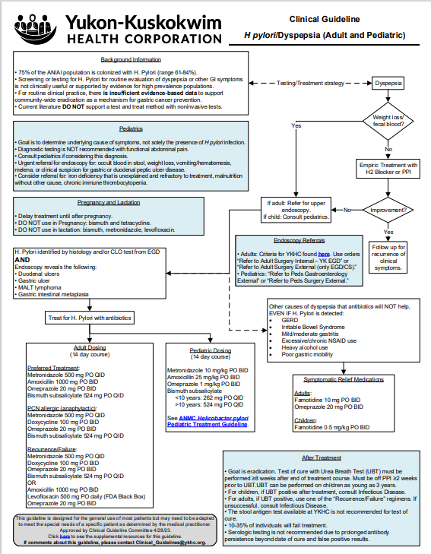
Click on image to show Clinical Guidelines in a large, readable format

Slide 54
Surgical Case Management
Please do not place duplicate orders for pts it will not get them seen any faster here or at ANMC. ANMC referrals are good for 12 months. Right now ANMC is scoping pts several months after referral sent (referrals sent to ANMC in September were scoped March of this year or later…)
Right now we are working to uniformly update charts with all EGD/Colonoscopy info for all patients 40 years or older, more info to come. For now, if you see Devon Jeppesen’s name in a chart it is likely updated with all EGD/Colonoscopy info up to that date.
Feel free to reach out Devon via TT or phone with questions any time. She is happy to look and see if a patient is due or if they clear for scope here but please remember there is only one surgical CM for all providers here at YK so it may take time for me to respond.

Slide 55
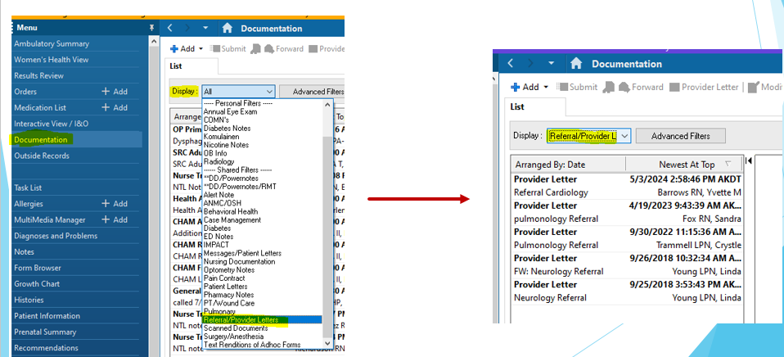
General Information – Set filters to check on past referrals prior to placing new ones
Check the shown filter to see what referrals have been sent on any given patient. This will cut down on duplicate referrals, and unnecessary requests to find basic information on when/if referrals have been placed.

Slide 56
Has a referral been placed already within the last year?
If yes, then the patient likely does not need a new referral, unless there is an entirely new set of symptoms.
If you determine no referral needed, have the patient call the ANMC service for an appt. this is the fastest way for patients to get scheduled. Case managers cannot schedule ANMC appts for patients.
How do I tell the patient to call? Recall these referral orders have ANMC numbers in them. If you place the order, but do not sign it, you can look at the number in the order details. Just refresh the chart without signing it, and the order will disappear.

Slide 57
General Information – remember effective communication is key
Send NON-URGENT requests to the appropriate message pool, not individually.

Slide 58
Thank you for your time and attention.
This is a lot of information and this module is intended for you to have as a reference guide as well.
Please request a copy of this presentation if you found it helpful.

